Slide 1
Severe Thunderstorms
CERT Basic Training
Hazards

Slide 2
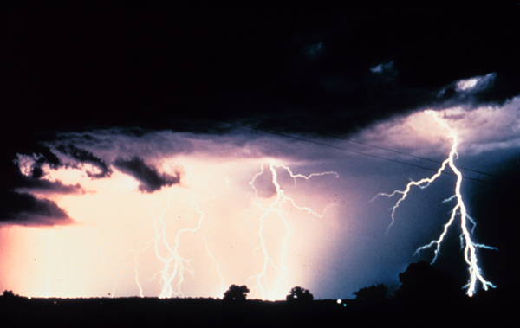
A Severe Thunderstorm …
Produces hail at least ¾ inch in diameter
Has winds of 58 miles per hour or higher
Produces a tornado

Slide 3
Thunderstorm Risks
Lightning
Hail
Downbursts and straight-line winds
Flash floods
Tornadoes

Slide 4
Thunderstorm Preparedness
Understand the risk
Learn to make a small target
Pay attention to warnings
Check for hazards in your yard
Bring outdoor furniture inside
Remove dead or overhanging limbs
Notes:
3

Slide 5
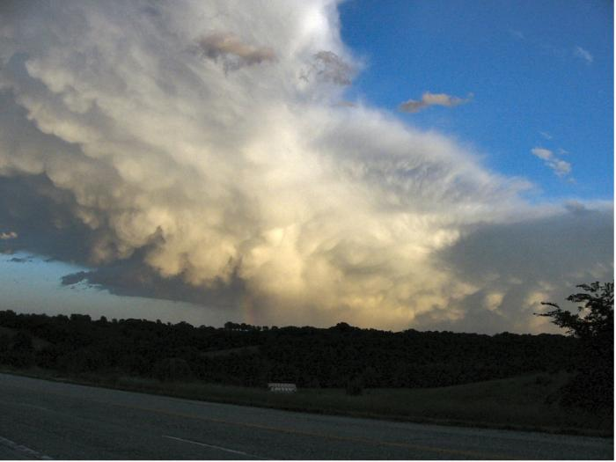
During a Thunderstorm
Things to avoid
Water sources
Telephone
Being outdoors
Notes:
4

Slide 6
If You Are Outdoors
Get away from water sources
Seek shelter in substantial building
If necessary:
Take shelter in car or
Go to low-lying area and make small target
Avoid natural lightning rods
Notes:
5

