Slide 1
Tsunamis
CERT Basic Training
Hazards

Slide 2
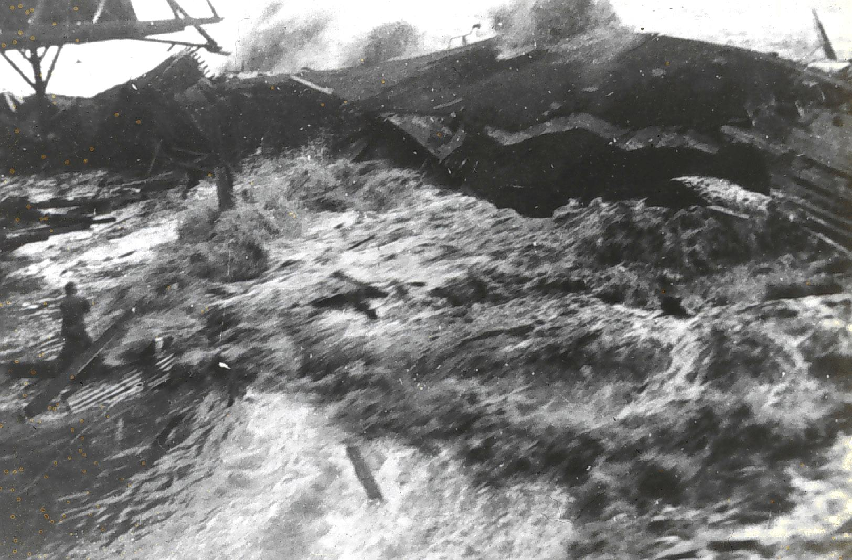
A Tsunami Is…
An ocean wave produced by underwater earthquakes or landslides

Slide 3
Tsunami Risks
Flooding
Contamination of drinking water
Fires from ruptured tanks or gas lines
Loss of vital community infrastructure
Complete devastation of coastal areas
Death

Slide 4
Tsunami Facts
24 tsunamis have caused damage in U.S. and territories during past 224 years
Wave height ranges: inches to 100+ feet
Tsunamis can travel upstream in coastal estuaries and rivers
Damaging waves as high as 60 feet extending inland from immediate coast
First wave of tsunami is usually not largest
Notes:
3

Slide 5
Tsunami Preparedness
Know risk and “coastal clues”
Plan and practice evacuation routes
Discuss tsunamis with your family
Talk to your insurance agent
Use NOAA Weather Radio
Notes:
4

Slide 6
Protecting Property
Avoid living within several hundred feet of coastline
Elevate coastal homes
Consult with professional
Notes:
5

Slide 7
Tsunami Preparedness
If strong, coastal earthquake occurs:
Drop, cover, and hold
When shaking stops, evacuate quickly to higher ground away from coast, up to two miles inland
Gather your family
Leave everything else behind
Avoid downed power lines, buildings, and bridges
Notes:
6

Slide 8
If a Warning is Issued
If in tsunami risk area, evacuate immediately
Follow instructions issued by local authorities
Get to higher ground as far inland as possible
Listen to NOAA Weather Radio or Coast Guard emergency frequency station
Return home only after local officials tell you that it is safe
If already out on ocean, be sure to get as far from coast as possible
7
Notes:
7

